Slide 1
I’ve got an Idea
By Lukas Joergensen

Slide 2
Agenda
Motivation
Why IntelliJ?
The IDEA platform
The exercises

Slide 3
Motivation
Efficient coding is important for productivity
Shortening the time you spend on chores and boilerplate, makes you more likely to focus on pretty code
Refactoring is faster and results in better code

Slide 4
Why IntelliJ?
IntelliJ is a great professional tool, which has a relative low cost
It builds on the IDEA platform, which supports a multitude of languages
You will feel familiar in all their IDE’s, which support PHP, C++, Scala, Python and more
Extendible, with easy plug-in downloads to add support for a lot of different features, such as MarkDown support
Unbeatable refactoring tools and code generation

Slide 5
The Exercises
Download from GitHub
https://github.com/lukaspj/STT-IDEA-Talk
FirstSteps
Simple exercises with lots of helpful comments in them
Beginner level and very short
DrawingBlocks
You are on your own, a very simple framework
Three assignments to implement as practice

Slide 6
First steps
3 Exercises
Each exercise focuses on a different set of commands
Exercise 1 – Contextual Action command
Exercise 2 – Simple code generation and refactoring commands
Exercise 3 – Navigation commands, how to live without the cursor

Slide 7
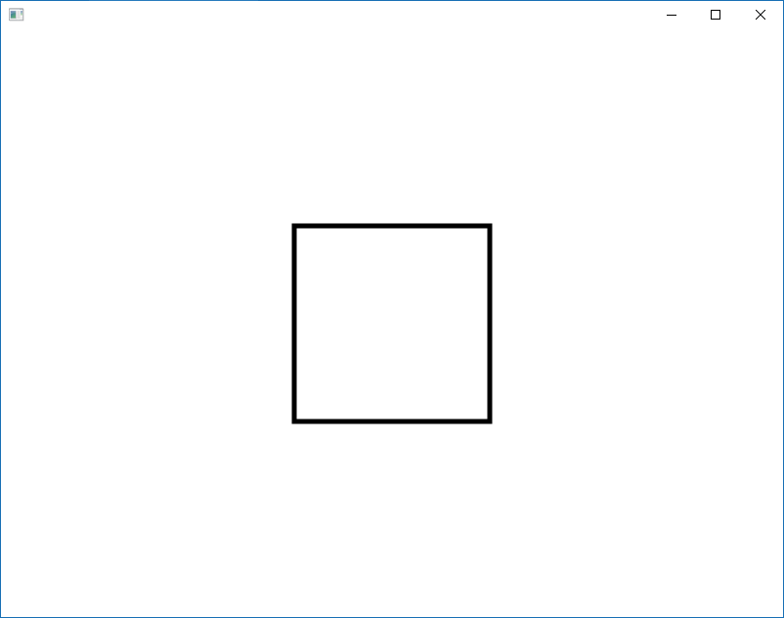
Drawing Blocks
new FigureDisplay(new RectangleBlock(new Vector2(400.0,300.0),200.0,200.0));
Position
Width
Height
A simple drawing framework
Write 3 extensions
Filled figures, not just outlines
Vary the colors of the figures
Create complex shapes, such as houses
Results in

